Slide 1
Portfolio workshop
2023-2024

Slide 2
timing
Faculty are eligible for promotion after 4 years in current rank.
Application happens at 3.5 years.
New TTF must apply for and receive tenure at the 4-year mark to continue employment. (Extensions are only available for extenuating circumstances but must be applied for before October 1.)
After the first promotion and/or tenure, faculty may take longer than 4 years if they choose.

Slide 3
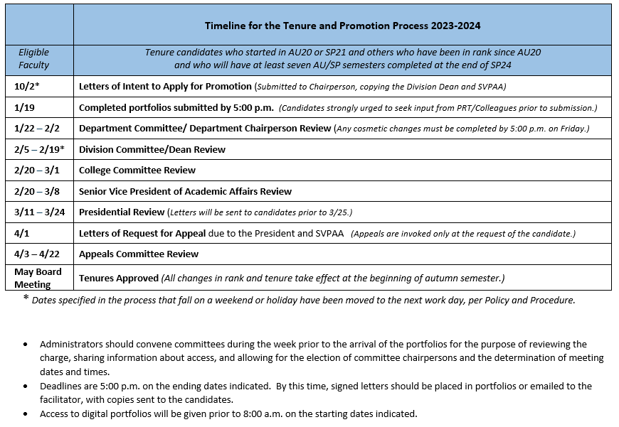

Slide 4
Portfolio contents
TWO SECTIONS

Slide 5
Section One
Cover Page
Table of Contents
Letter of Application
Opening Remarks
Letters of Recommendation
Annual Faculty Performance Appraisals
Faculty Observation Reports

Slide 6
Section Two
A. Teaching and Learning Activities (Instruction, Assessment, Advising)
1. Teaching Philosophy and Narrative
2. Documentation
B. Professional Activities (Development, Scholarship, Service to Profession)
1. Narrative
2. Documentation
C. Service Activities (Department, Division, College, Community)
1. Narrative
2. Documentation

Slide 7
Cover Page
The cover/opening page of the portfolio must include the following information:
Name
Current Rank
Rank Applying For
Department
Division
Submission Date

Slide 8
Table of Contents
A detailed listing of every activity included in the portfolio rather than just a list of section titles.
Consider providing an attached copy that can be printed.

Slide 9
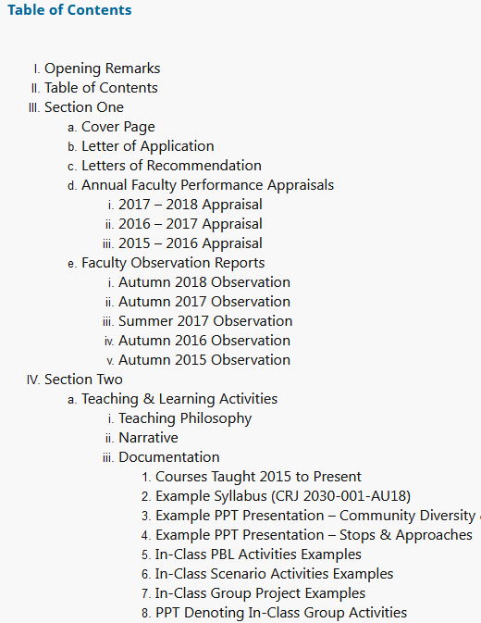
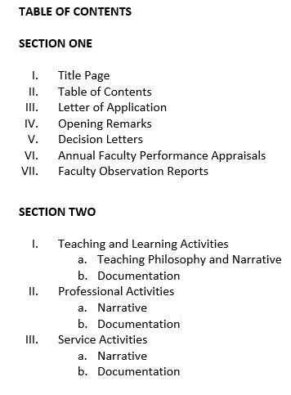

Slide 10
Letter of Application
A copy of the letter that was submitted to the department chairperson, the division dean, and the SVPAA by October 1.
Includes the faculty member’s name, current rank, and rank (and tenure, if applicable) being applied for
Sample letter is found in the appendix of the handbook.

Slide 11
Opening Remarks
The opening remarks are meant to set the stage for the portfolio, to provide a context. The remarks might include
your professional history
an explanation of your department and work requirements
a quotation or reference to a book
anything else significant to you
The tone may be formal or informal, as the candidate chooses.
Generally, opening remarks fall between 300 and 750 words.

Slide 12
Letters of Recommendation
Committees and administrators will write recommendation letters as the portfolio moves through the process. These letters will be sent to you and to the digital facilitator.
In your digital portfolio, placeholders are set up where the facilitator will add the letters.

Slide 13
Annual Appraisals
Include all appraisals since last promotion
Minimum of three
Reverse chronological order

Slide 14
Observation Reports
Refer to Handbook for numbers required
Reverse chronological order
If any are missing, include your own explanation (with documentation), or explanation from the chairperson and/or PRT.

Slide 15
Section Narratives
Start with a general intro to the section—stress growth and continuity.
Explain how and why included activities support exemplary performance.
Every activity mentioned must be supported by documentation; every piece of documentation should be alluded to in the narrative.

Slide 16
Teaching Philosophy
An articulation of the fundamental principles that guide a faculty member’s teaching, assessment, and advising strategies and overall approach to the discipline
The overarching objectives
Cognitive, behavioral, and affective goals
Info, skills, ethical considerations
Support generalizations with concrete examples
Explain course design related to goals
Discuss assessment methods that ensure achievement of objectives
Identify teaching behaviors that support goals

Slide 17
Documentation
Professional Development Reports, Committee Contribution Reports, emails, agendas, handouts, syllabi, thank-you notes, flyers, programs, minutes, reports, screen shots, letters, membership cards, certificates, transcripts, assessments, worksheets, lesson plans, scripts, lists, title pages, photographs, newspaper articles, etc.

Slide 18
General Documentation Tips
Never use the same piece of documentation twice in the portfolio.
Avoid including publisher materials or anything substantially created by another party—or justify it clearly in the narrative.
Be clear and specific about your role in the creation of digital media, departmental items, or group project documentation.
Redact names on documents to protect privacy (e.g., student assignments or recommendations, faculty observations, etc.).

Slide 19
General Documentation Tips
For assessments, provide rubrics, keys, or graded assignments showing the type of feedback given.
Choose documents that reflect actual contributions rather than future participation.

Slide 20
Top documentation tip—Be a minimalist!
Do not add multiple items to document one activity--choose the most effective proof.
Provide only a page or two of lengthy documents or large files with lots of graphics.
Be aware that reviewers will not view entire videos or full PowerPoints.
Provide representative examples of instructional units and other materials instead of multiple examples.

Slide 21
Preparing the portfolio

Slide 22
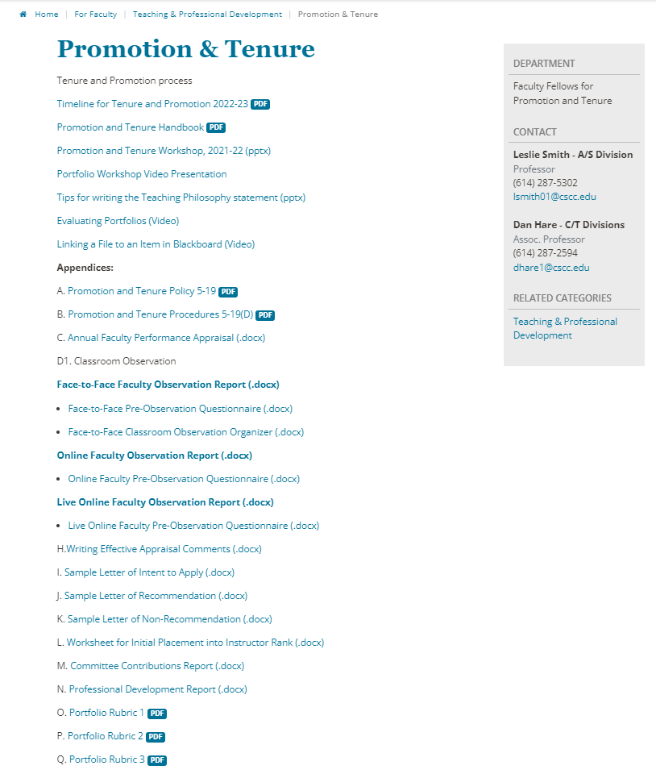
1. Review the current P&T handbook —and— view recent exemplary portfolios.

Slide 23
2. Gather required documents.
Appraisals
Observation Reports
Make sure they have all required signatures.
Chairs and Deans should have copies if you need them.

Slide 24
3. Decide what will be included in each section.
Review appraisals, calendars, emails, etc.

Slide 25
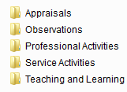
4. Find documentation for each item in each section.
Place items into actual or virtual folders.
Consider renaming items in a meaningful way and save as PDFs.

Slide 26
5. Put together a draft table of contents.
Share it with PRT for feedback.

Slide 27
6. Write narratives.
As you finish each one, share it with PRT for feedback.
Avoid adding special formatting until you copy it to Blackboard.

Slide 28
7. Once your narratives are written, revised, and edited, and once your documentation is organized, move to formatting.

Slide 29
Portfolio formatTING
Digital
Request the Blackboard organization template designed by the P&T Process Committee.

Slide 30
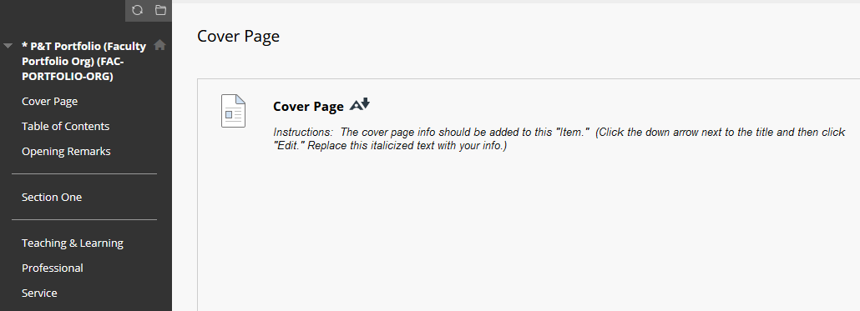
THE org template

Slide 31
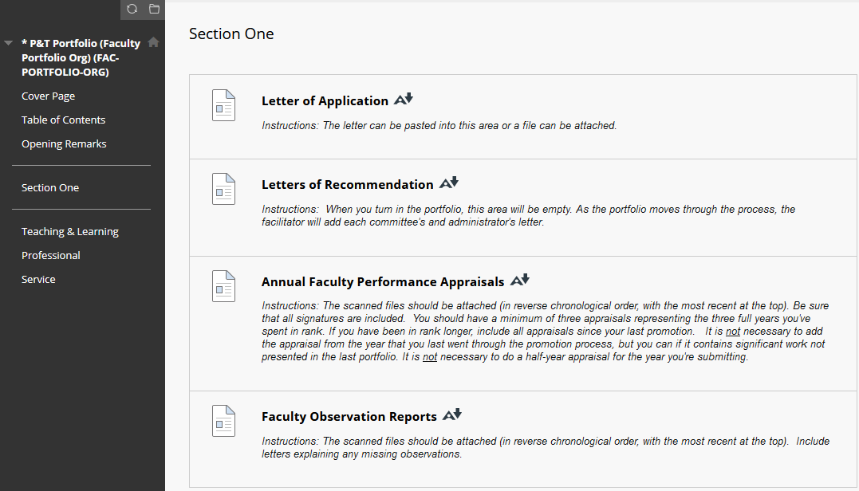

Slide 32
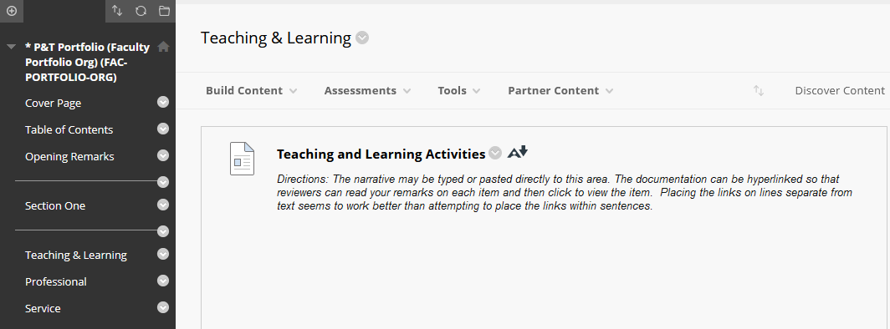

Slide 33
REQUESTING a portfolio org template
Send an email to teaching@cscc.edu requesting these things:
A new ORGANIZATION created for a promotion portfolio.
Titled something like this: Jane Doe Promotion Portfolio for Associate Professor
Using an identifier like this: FAC-PORTFOLIO-ORG-JDOE-2 (The number 2 on the end indicates this is the second promotion. A 1 would be used for the first, and a 3 for the last. This will ensure previous digital portfolios are not overwritten.)
The FAC-PORTFOLIO-ORG copied to it.
Yourself added as LEADER—ENROLL.
In December, you’ll need to request that the two P&T facilitators be added as LEADER—ENROLL. (The names of the facilitators will be shared prior to December each year.)

Slide 34
After submission of the portfolio on the first Friday of Spring Semester, the two facilitators will handle all the additions and deletions of committee and administrative readers (as participants) and the uploading of decision letters. The candidate will be removed once the portfolio has been submitted (and re-added briefly if cosmetic fixes are required). After the process is complete, the candidate will be added back as a Leader—Enroll and the facilitators can be removed.

Slide 35
Necessary Skills for Digital Portfolios:
Scanning Documents
Creating PDFs
Adding “Items” and “Files” to Blackboard
Renaming files
Adding to organization content
Creating links to files
Adding videos

Slide 36
DEIS is happy to help, and the P&T Process Committee can offer assistance.

Slide 37
General Tip:
Start early!
Set a goal date of November 20th to have everything done except final reviews and edits.

Slide 38
RESOURCES
3dman_eu Pixabay

Slide 39
For general portfolio information:
Leslie Smith, Faculty Fellow
Dan Hare, Faculty Fellow
Heather Johnston, P&T Process Committee
Jeremy Banta, P&T Process Committee
For digitizing assistance:
DEIS
Dann Marketos
Nick Lakostik
Dan Hare

Slide 40
Thank You!
Portfolio Workshop
2023-2024

Slide 41
Choosing a format—Considerations
Paper or Digital
Neither is easier—they just present different challenges.
Focus on your comfort level.

Slide 42
Paper portfolio
One 3-ring binder—two to five inches wide
Tabbed dividers for major sections
Sheet protectors—used judiciously

Slide 43
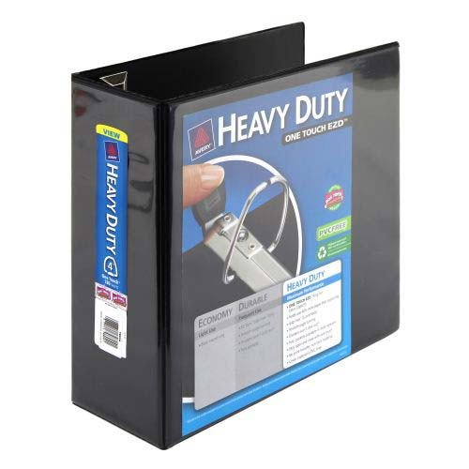
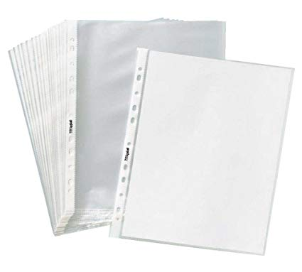
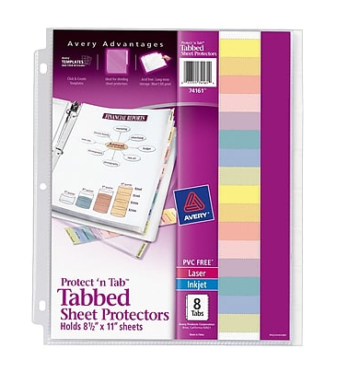

Slide 44
Paper portfolios
The spine of paper portfolios must include the following:
Name
Department
Rank Applying For

Slide 45
Paper portfolios
A laminated copy of the Table of Contents may be placed in the front pocket of the binder if desired.
Include seven empty sheet protectors for the letters of recommendation. Committees and administrators will add recommendation letters as the portfolio moves through the process.
Ensure that all pages within sheet protectors are visible without removal.

